Slide 1

Integer Programming
MTH 564 – Mathematical Modeling

Slide 2
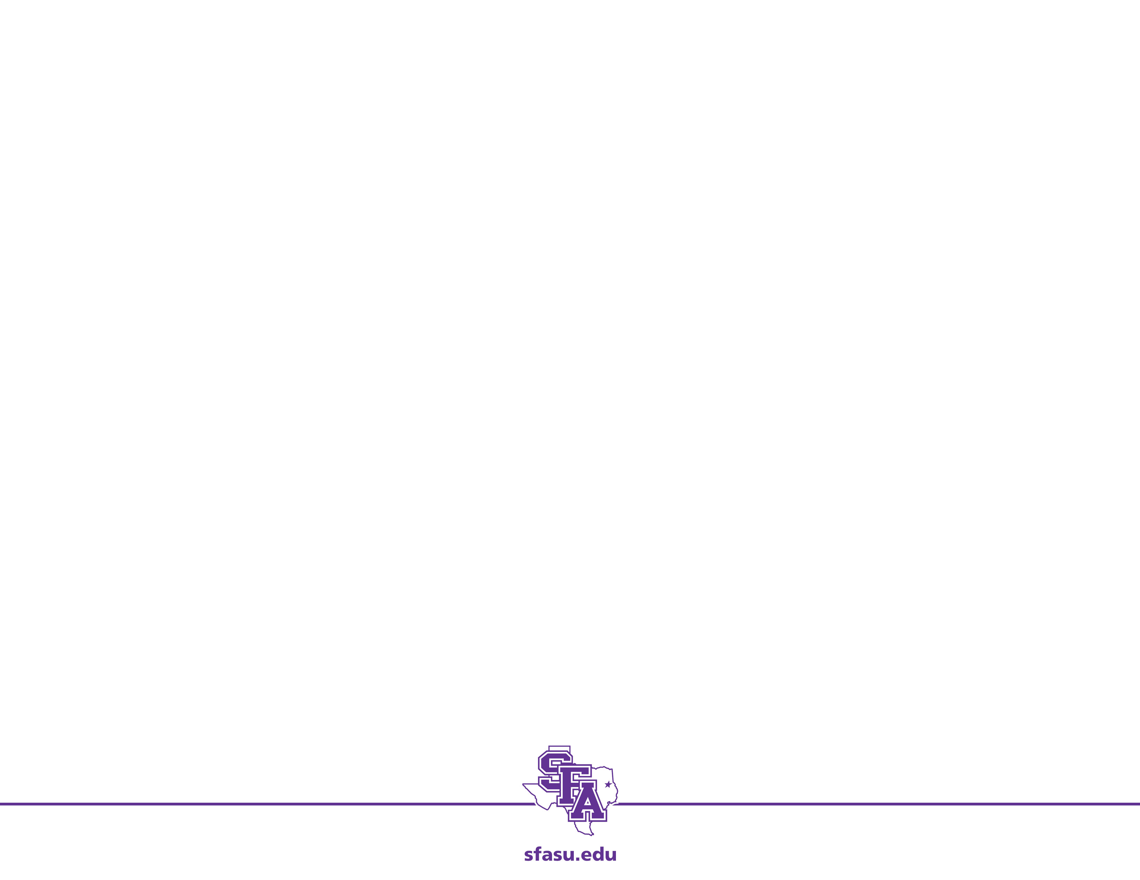
Example: Farming
A family farm has 625 acres available for planting. The plots are divided into five 120 acre plots and one 25 acre plot. The family is considering planting corn, wheat, and oats. It is anticipated that 1,000 acre-ft of water will be available for irrigation, and the farmers will be able to devote 300 hours of labor per week. Additional data is presented in the table below. Find the amount of each crop that should be planted for maximum profit.
Requirement (per acre) | Corn | Wheat | Oats
Irrigation (acre-ft) | 3.0 | 1.0 | 1.5
Labor (hrs/week) | 0.8 | 0.2 | 0.3
Yield ($) | 400 | 200 | 250

Slide 3
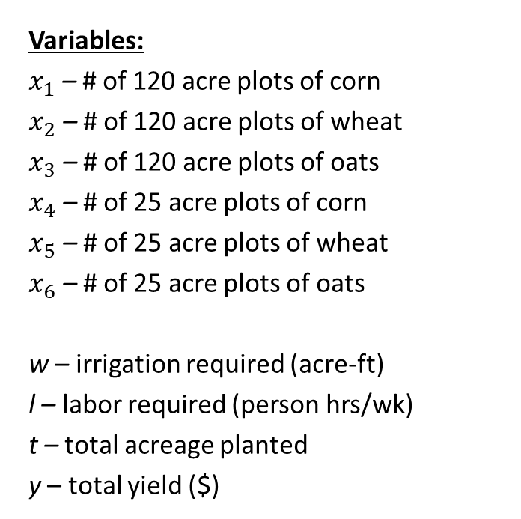
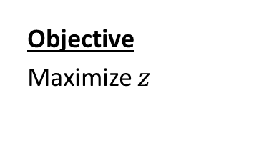
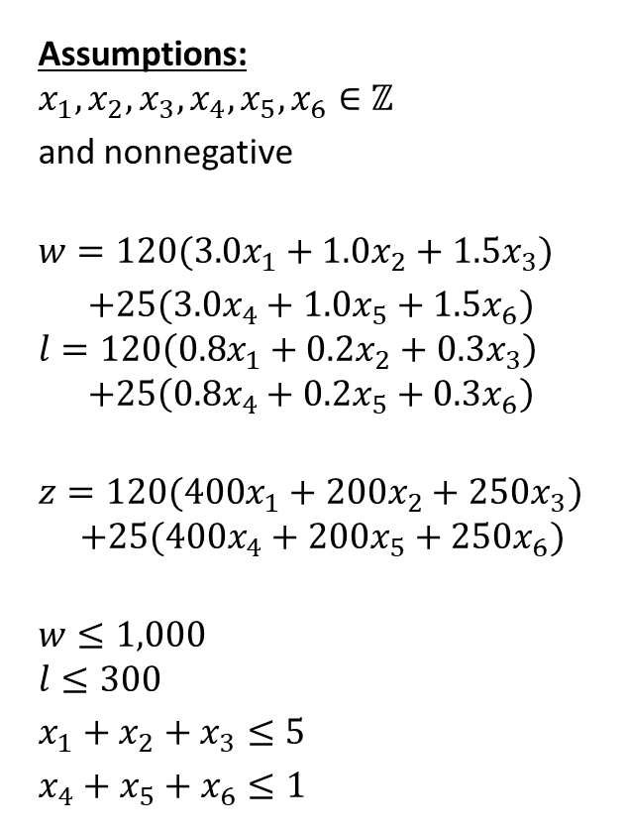
Step 1: Ask the question.
Variables:
$x_{1}$ – # of 120 acre plots of corn
$x_{2}$ – # of 120 acre plots of wheat
$x_{3}$ – # of 120 acre plots of oats
$x_{4}$ – # of 25 acre plots of corn
$x_{5}$ – # of 25 acre plots of wheat
$x_{6}$ – # of 25 acre plots of oats
w – irrigation required (acre-ft)
l – labor required (person hrs/wk)
t – total acreage planted
y – total yield ($)
Assumptions:
$$x_{1}, x_{2}, x_{3},x_{4},x_{5},x_{6}∈ℤ$$
and nonnegative
$$w=120(3.0x_{1}+1.0x_{2}+1.5x_{3})$$
$+25(3.0x_{4}+1.0x_{5}+1.5x_{6})$
$$l=120\left(0.8x_{1}+0.2x_{2}+0.3x_{3}\right)$$
$$+25\left(0.8x_{4}+0.2x_{5}+0.3x_{6}\right)$$
$$z=120({400x}_{1}+{200x}_{2}+{250x}_{3})$$
$$+25({400x}_{4}+{200x}_{5}+{250x}_{6})$$
$$w≤1,000$$
$$l≤300$$
$x_{1}+x_{2}+x_{3}≤5$
$x_{4}+x_{5}+x_{6}≤1$
Objective
Maximize $z$

Slide 4
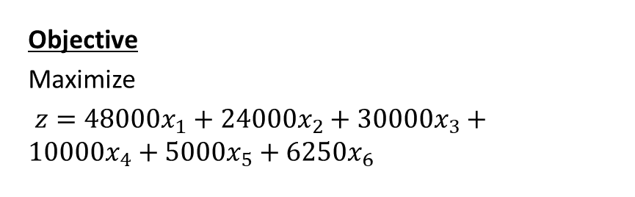
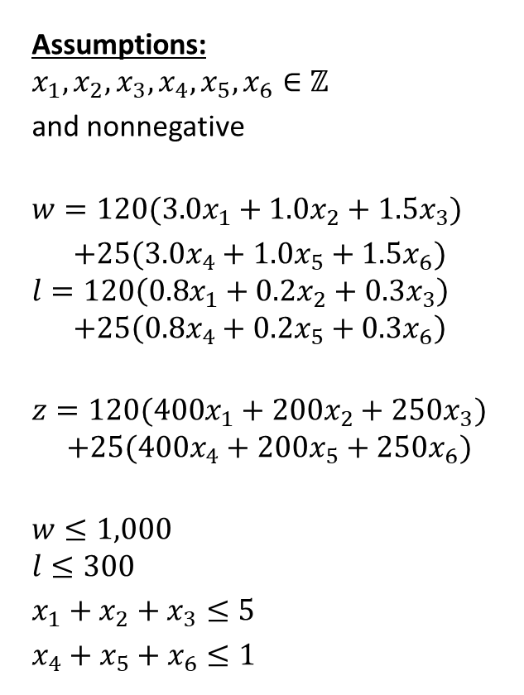
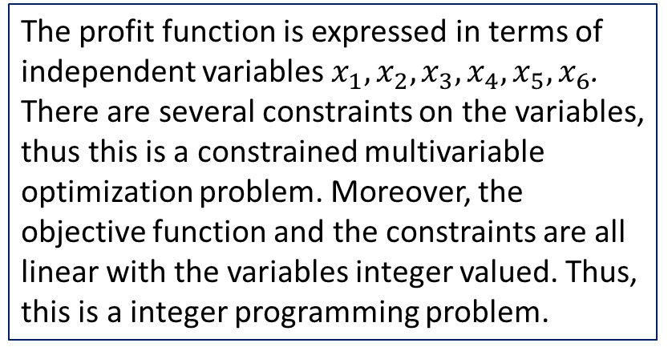
Step 2: Select the modeling approach
Assumptions:
$$x_{1}, x_{2}, x_{3},x_{4},x_{5},x_{6}∈ℤ$$
and nonnegative
$$w=120(3.0x_{1}+1.0x_{2}+1.5x_{3})$$
$+25(3.0x_{4}+1.0x_{5}+1.5x_{6})$
$$l=120\left(0.8x_{1}+0.2x_{2}+0.3x_{3}\right)$$
$$+25\left(0.8x_{4}+0.2x_{5}+0.3x_{6}\right)$$
$$z=120({400x}_{1}+{200x}_{2}+{250x}_{3})$$
$$+25({400x}_{4}+{200x}_{5}+{250x}_{6})$$
$$w≤1,000$$
$$l≤300$$
$x_{1}+x_{2}+x_{3}≤5$
$x_{4}+x_{5}+x_{6}≤1$
Objective
Maximize
$z=48000x_{1}+24000x_{2}+30000x_{3}+10000x_{4}+5000x_{5}+6250x_{6}$
The profit function is expressed in terms of independent variables $x_{1}, x_{2}, x_{3},x_{4},x_{5},x_{6}$. There are several constraints on the variables, thus this is a constrained multivariable optimization problem. Moreover, the objective function and the constraints are all linear with the variables integer valued. Thus, this is a integer programming problem.

Slide 5
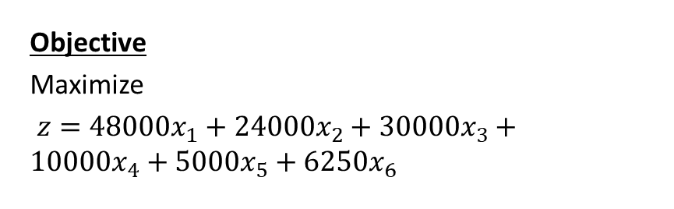
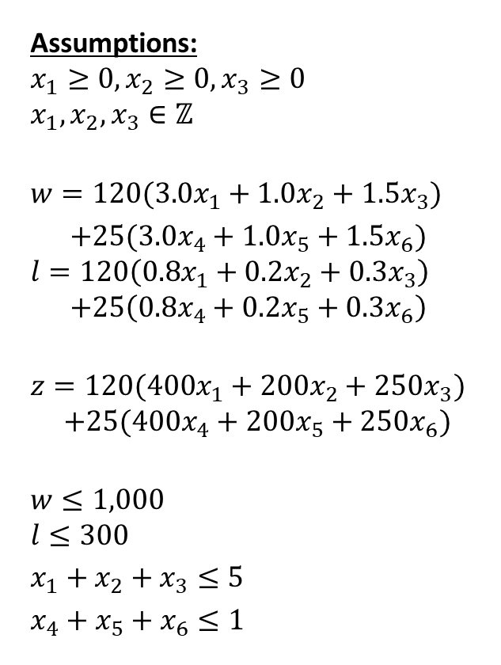
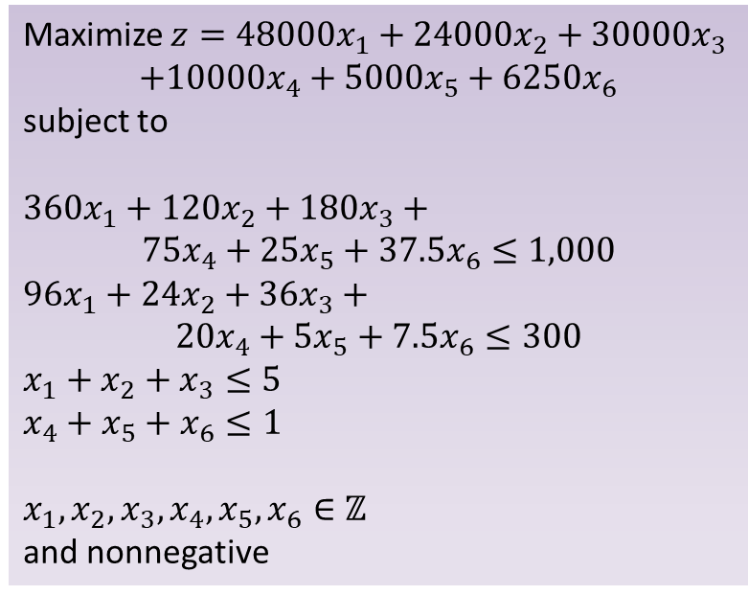
Step 3: Formulate the Model
Assumptions:
$$x_{1}≥0, x_{2}≥0, x_{3}≥0$$
$$x_{1}, x_{2}, x_{3}∈ℤ$$
$$w=120(3.0x_{1}+1.0x_{2}+1.5x_{3})$$
$+25(3.0x_{4}+1.0x_{5}+1.5x_{6})$
$$l=120\left(0.8x_{1}+0.2x_{2}+0.3x_{3}\right)$$
$$+25\left(0.8x_{4}+0.2x_{5}+0.3x_{6}\right)$$
$$z=120({400x}_{1}+{200x}_{2}+{250x}_{3})$$
$$+25({400x}_{4}+{200x}_{5}+{250x}_{6})$$
$$w≤1,000$$
$$l≤300$$
$x_{1}+x_{2}+x_{3}≤5$
$x_{4}+x_{5}+x_{6}≤1$
Objective
Maximize
$z=48000x_{1}+24000x_{2}+30000x_{3}+10000x_{4}+5000x_{5}+6250x_{6}$
Maximize $z=48000x_{1}+24000x_{2}+30000x_{3}$
$$+10000x_{4}+5000x_{5}+6250x_{6}$$
subject to
$360x_{1}+120x_{2}+180x_{3}+$
$$75x_{4}+25x_{5}+37.5x_{6}≤1,000$$
$96x_{1}+24x_{2}+36x_{3}+$
$$20x_{4}+5x_{5}+7.5x_{6}≤300$$
$x_{1}+x_{2}+x_{3}≤5$
$x_{4}+x_{5}+x_{6}≤1$
$$x_{1}, x_{2}, x_{3},x_{4},x_{5},x_{6}∈ℤ$$
and nonnegative

Slide 6
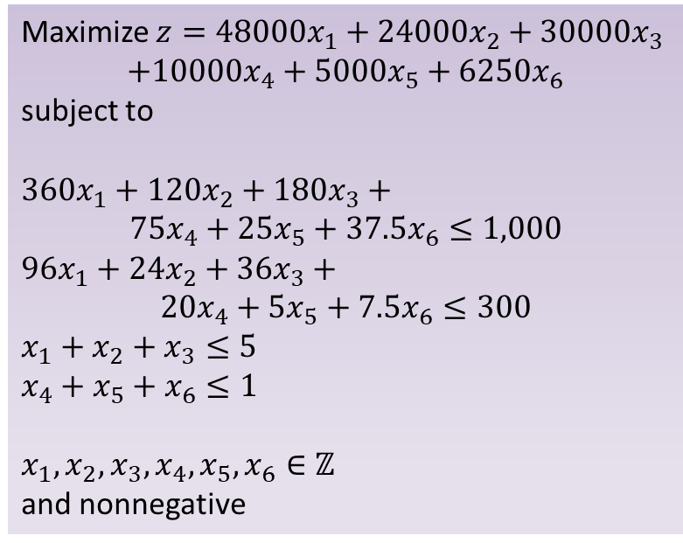
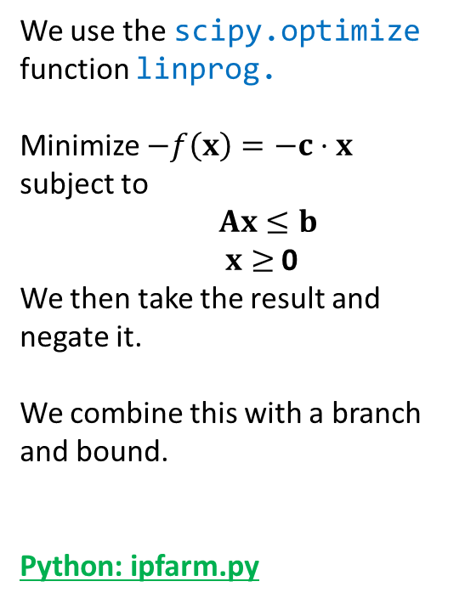
Step 4: Solve the Problem
We use the scipy.optimize function linprog.
Minimize $−f\left(x\right)=−c⋅x$ subject to
$Ax≤b$ $x≥$ 0
We then take the result and negate it.
We combine this with a branch and bound.
Python: ipfarm.py
Maximize $z=48000x_{1}+24000x_{2}+30000x_{3}$
$$+10000x_{4}+5000x_{5}+6250x_{6}$$
subject to
$360x_{1}+120x_{2}+180x_{3}+$
$$75x_{4}+25x_{5}+37.5x_{6}≤1,000$$
$96x_{1}+24x_{2}+36x_{3}+$
$$20x_{4}+5x_{5}+7.5x_{6}≤300$$
$x_{1}+x_{2}+x_{3}≤5$
$x_{4}+x_{5}+x_{6}≤1$
$$x_{1}, x_{2}, x_{3},x_{4},x_{5},x_{6}∈ℤ$$
and nonnegative

Slide 7


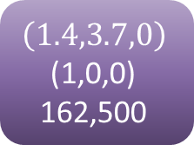








Example: Branch and Bound
(2,2.3,0)
(0,0,0)
152,000
(1,3,1)
(1,0,0)
160,000
$$x_{1}≥1$$
$$x_{2}≥3$$
$$\left(1.4,3.7,0\right)$$
(1,0,0)
162,500
(1,2.6,1.4)
(1,0,0)
162,500
(1,2,1.8)
(1,0,0)
160,167
$$x_{1}=1$$
$$x_{4}=1$$
(0.1,0,4.9)
(1,0,0)
162,500
(1,2,2)
(0.3,0.7,0)
162,500
$$x_{2}≤2$$
$$x_{1}≤1$$
(0,0,5)
(1,0,0)
160,000
(1,1.96,2.04)
(0,0,1)
162,500
$x_{1}=$0
$$x_{4}=0$$
$$x_{2}≤1$$
Note: There were 5*5*5*2*2*2= 1,000 possible solutions but by branching and bounding reduced the amount we needed to consider.
$$x_{2}=2$$
(1,1,2.75)
(0,1,0)
159,500
(1,2,2)
(0,0,1)
162,250
Notes:
Let L be a list of node. Start with L ={Original LP} initially
Let max_z be the current max to problem (initially the solution to the LP)
While L is not empty
pick a element from the list
if node is infeasible, do not branch
if the node solution are all integers, do not branch
compare to the best solution
update the best integer solution if this is better
if solution is not an integral
if the objective value is worse
do not branch
else
create two new branches and add to the list
End while
Return the best integer solution.
Pseudo-Code
Find a solution using LP. If it’s an integer stop.
Create two LPs with added constraints on a noninteger part of the solution.
Add non promising node to a “dangle” list D

Slide 8
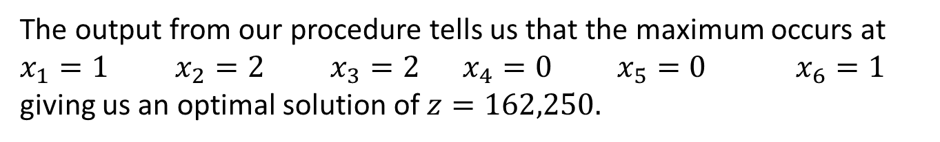
Step 4: Solve the Problem
The output from our procedure tells us that the maximum occurs at
$x_{1}=1$ $x_{2}=2$ $x_{3}=2$ $x_{4}=0$ $x_{5}=0$ $x_{6}=1$
giving us an optimal solution of $z=162,250.$

Slide 9
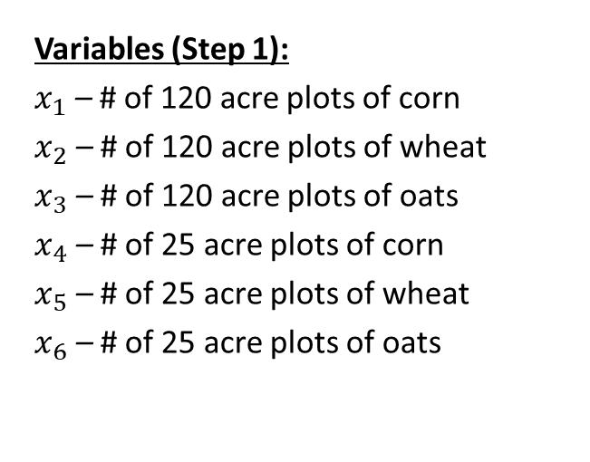
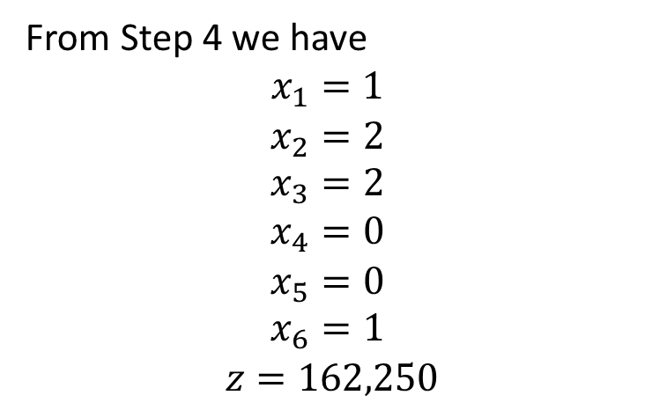
Step 5: Answer the question
From Step 4 we have
$$x_{1}=1$$
$$x_{2}=2 \\ x_{3}=2$$
$$x_{4}=0$$
$$x_{5}=0 \\ x_{6}=1$$
$$z=162,250$$
Variables (Step 1):
$x_{1}$ – # of 120 acre plots of corn
$x_{2}$ – # of 120 acre plots of wheat
$x_{3}$ – # of 120 acre plots of oats
$x_{4}$ – # of 25 acre plots of corn
$x_{5}$ – # of 25 acre plots of wheat
$x_{6}$ – # of 25 acre plots of oats
If the family does not wish to split up the plots, then the best plan is to plant one 120 acre of plot of corn, two 120 acre plots of wheat, two 120 acre plots of oats, and one 25 acre plot of oats. This should yield $162,250 for the season.

Slide 10
Comparison
Original (LP): The optimal solution is to plant 187.5 acres of corn, 437.5 acres of wheat, and no oats. This should yield $162,500. The optimal solution uses all 1,000 acre-ft of irrigation and all 625 acres. Of the 300 available person-hours of labor per week 62.5 are unused.
Current (IP): If the family does not wish to split up the plots, then the best plan is to plant one 120 acre of plot of corn, two 120 acre plots of wheat, two 120 acre plots of oats, and one 25 acre plot of oats. This should yield $162,250 for the season.
Comparison: The difference between the two maximum yields is only $250—about 0.2% less than the original.

Slide 11
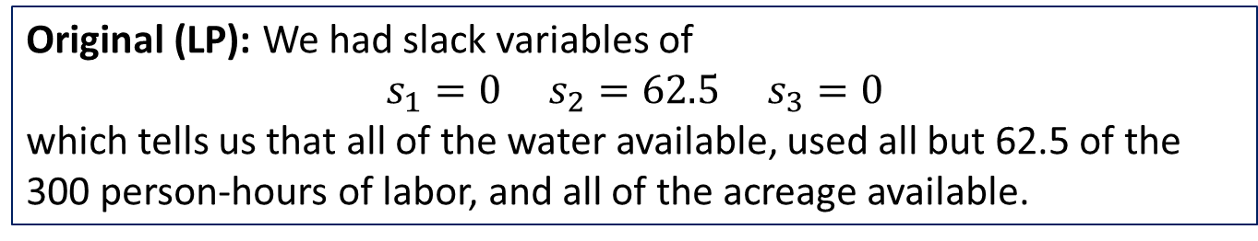
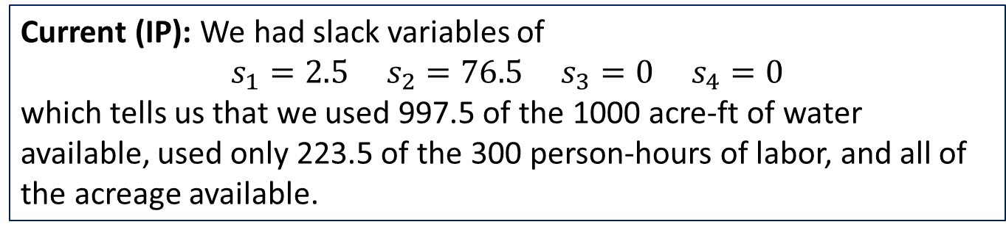
Comparison: Slack
Original (LP): We had slack variables of
$$s_{1}=0 s_{2}=62.5 s_{3}=0$$
which tells us that all of the water available, used all but 62.5 of the 300 person-hours of labor, and all of the acreage available.
Current (IP): We had slack variables of
$$s_{1}=2.5 s_{2}=76.5 s_{3}=0 s_{4}=0$$
which tells us that we used 997.5 of the 1000 acre-ft of water available, used only 223.5 of the 300 person-hours of labor, and all of the acreage available.
Decision: We leave it to the family to decide what is best. Perhaps they can sell the unused resources to make up for the difference in optimal solutions.
Notes:
Also, $250 might not be worth the hassle of dividing plots.

Slide 12
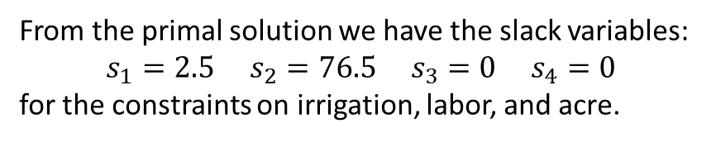
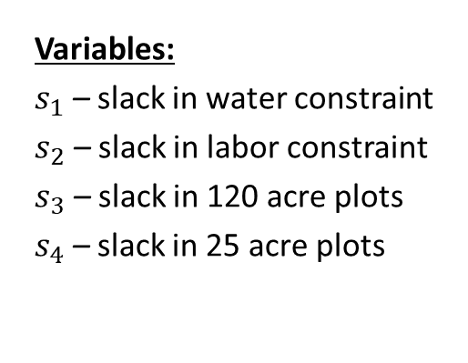
Farm Example: Shadow Prices
From the primal solution we have the slack variables:
$$s_{1}=2.5 s_{2}=76.5 s_{3}=0 s_{4}=0$$
for the constraints on irrigation, labor, and acre.
Variables:
$s_{1}$ – slack in water constraint
$s_{2}$ – slack in labor constraint
$s_{3}$ – slack in 120 acre plots
$s_{4}$ – slack in 25 acre plots
Interpretation
It is probably not worth considering shadow prices in this problem. Note that there is an excess of both water and labor. Thus, buying more will not increase the farmer’s profit. Hence the shadow prices for these will be 0.
We did use up all the acreage, however it is unlikely that there is a 120 acre or 25 acre lot for purchase that will be ready to use in this season. We should pursue this shadow price only if the farmer has the means and opportunity to purchase additional land.

Slide 13
Sensitivity Analysis
Sensitivity Analysis can be very time-consuming for integer programming problems.
In general IPs take a lot longer to solve than LPs.
Many times the best course of action is simply to change the constraint objective function a relatively small amount and observe what happens to your model.
Yield Parameters:
$400 – yield per acre of corn
$200 – yield per acre of wheat
$250 – yield per acre of oats
Constraint Parameters:
1000 – amount of water available
300 – amount of hours available
625 – total acres available

Slide 14
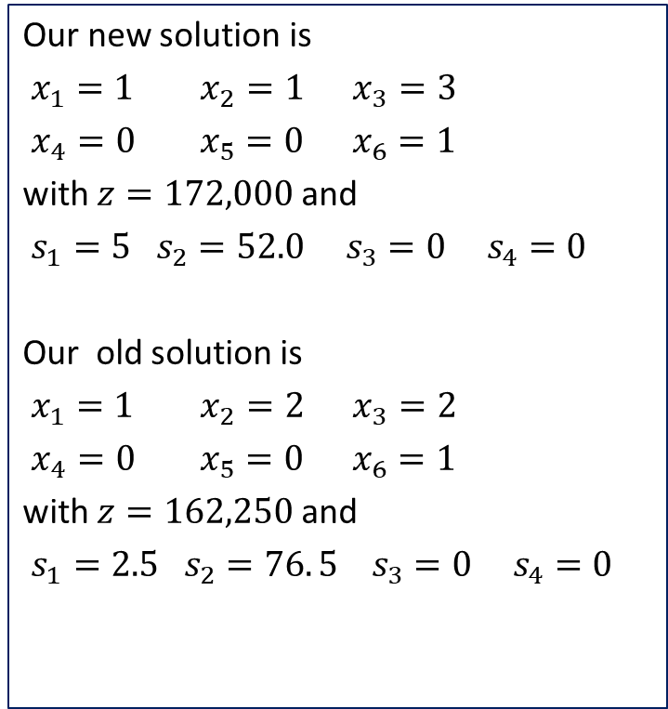
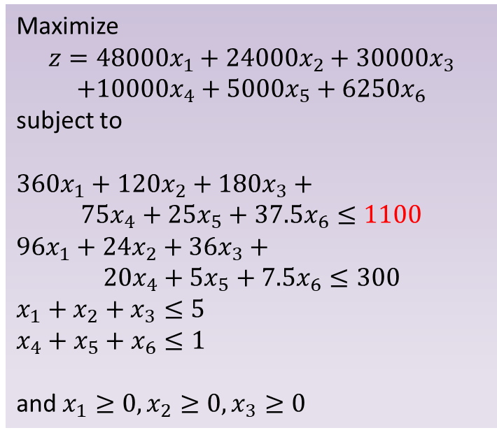
Sensitivity: Water Increase
Suppose the constraint for water increases from 1000 to 1100.
Our new solution is
$x_{1}=1$ $x_{2}=1$ $x_{3}=3$
$x_{4}=0 x_{5}=0 x_{6}=1$
with $z=172,000$ and
$s_{1}=5 s_{2}=52.0 s_{3}=0 s_{4}=0$
Our old solution is
$x_{1}=1$ $x_{2}=2$ $x_{3}=2$
$x_{4}=0 x_{5}=0 x_{6}=1$
with $z=162,250$ and
$s_{1}=2.5 s_{2}=76. 5 s_{3}=0 s_{4}=0$
Maximize
$$z=48000x_{1}+24000x_{2}+30000x_{3}$$
$$+10000x_{4}+5000x_{5}+6250x_{6}$$
subject to
$360x_{1}+120x_{2}+180x_{3}+$
$$75x_{4}+25x_{5}+37.5x_{6}≤1100$$
$96x_{1}+24x_{2}+36x_{3}+$
$$20x_{4}+5x_{5}+7.5x_{6}≤300$$
$x_{1}+x_{2}+x_{3}≤5$
$x_{4}+x_{5}+x_{6}≤1$
and $x_{1}≥0, x_{2}≥0, x_{3}≥0$

Slide 15
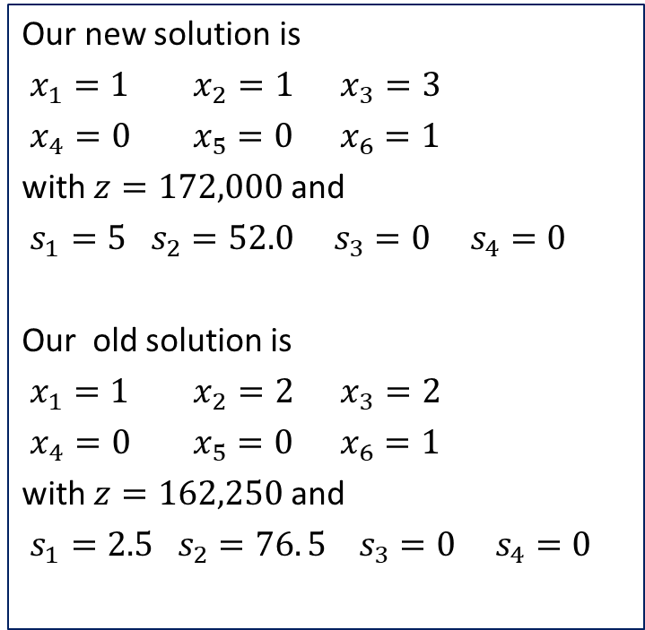
Sensitivity: Water Increase
Our new solution is
$x_{1}=1$ $x_{2}=1$ $x_{3}=3$
$x_{4}=0 x_{5}=0 x_{6}=1$
with $z=172,000$ and
$s_{1}=5 s_{2}=52.0 s_{3}=0 s_{4}=0$
Our old solution is
$x_{1}=1$ $x_{2}=2$ $x_{3}=2$
$x_{4}=0 x_{5}=0 x_{6}=1$
with $z=162,250$ and
$s_{1}=2.5 s_{2}=76. 5 s_{3}=0 s_{4}=0$
We now plant one 120 plot of corn and one 120 acre plot of wheat. Oats is planted everywhere else. We have 5 acre-ft of water left over and 52 person-hrs/wk of labor. The yield increases by $9,750
Our model is very sensitive to irrigation even though it was a non-binding constraint.
What happens if irrigation decreases?

Slide 16
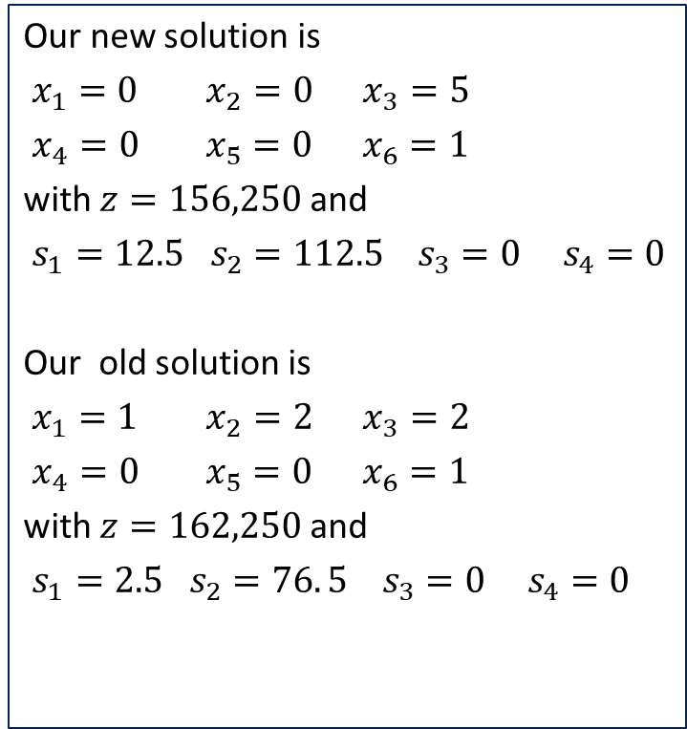
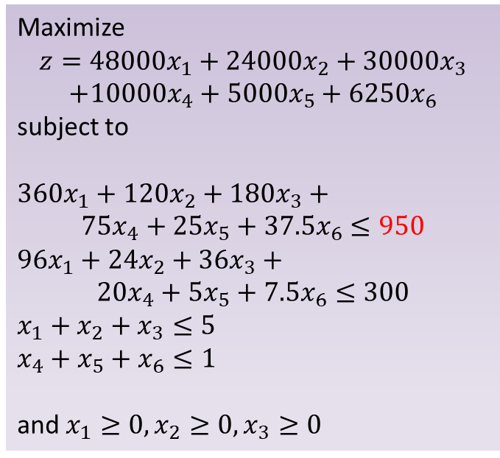
Sensitivity: Water Decrease
Suppose the constraint for water increases from 1000 to 950.
Our new solution is
$x_{1}=0$ $x_{2}=0$ $x_{3}=5$
$x_{4}=0 x_{5}=0 x_{6}=1$
with $z=156,250$ and
$s_{1}=12.5 s_{2}=112.5 s_{3}=0 s_{4}=0$
Our old solution is
$x_{1}=1$ $x_{2}=2$ $x_{3}=2$
$x_{4}=0 x_{5}=0 x_{6}=1$
with $z=162,250$ and
$s_{1}=2.5 s_{2}=76. 5 s_{3}=0 s_{4}=0$
Maximize
$$z=48000x_{1}+24000x_{2}+30000x_{3}$$
$$+10000x_{4}+5000x_{5}+6250x_{6}$$
subject to
$360x_{1}+120x_{2}+180x_{3}+$
$$75x_{4}+25x_{5}+37.5x_{6}≤950$$
$96x_{1}+24x_{2}+36x_{3}+$
$$20x_{4}+5x_{5}+7.5x_{6}≤300$$
$x_{1}+x_{2}+x_{3}≤5$
$x_{4}+x_{5}+x_{6}≤1$
and $x_{1}≥0, x_{2}≥0, x_{3}≥0$
Notes:
Note: changing to 997.5 won’t do anything because we are not using some water

Slide 17

Sensitivity: Water Decrease
Our new solution is
$x_{1}=0$ $x_{2}=0$ $x_{3}=5$
$x_{4}=0 x_{5}=0 x_{6}=1$
with $z=156,250$ and
$s_{1}=12.5 s_{2}=112.5 s_{3}=0 s_{4}=0$
Our old solution is
$x_{1}=1$ $x_{2}=2$ $x_{3}=2$
$x_{4}=0 x_{5}=0 x_{6}=1$
with $z=162,250$ and
$s_{1}=2.5 s_{2}=76. 5 s_{3}=0 s_{4}=0$
We now plant oats on all 625 acres. We have 12.5 acre-ft of water left over and 112.5 person-hrs/wk of labor to spare. The yield goes down by $6,000.
Our model is very sensitive to irrigation even though it was a non-binding constraint.
A 5% decrease in the amount of available irrigation water drastically changed the crops to plant.

Slide 18
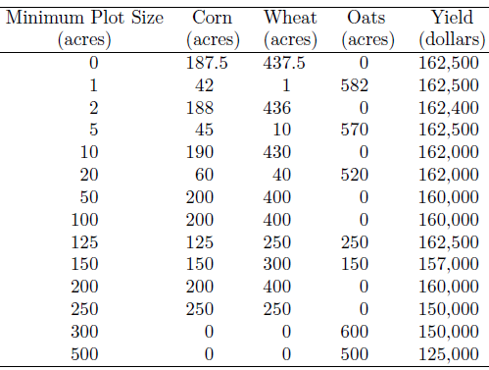
Sensitivity Analysis: Plot Size
We have already mentioned that it is unlikely that the overall number of acres the farmer has at his disposal will Increase.
However, the farmer can change the size of the plot. That is, instead of 120 acre plots, he may do 125 acres or 50 acre plots.
Geometrically, having smaller plot sizes gives us many more possibilities for solutions for the IP (and less change in our objective function.)
Notes:
for some of these there is unplanted acreage
The solution changes significantly in the table
Having 5 plots at 125 actually gives you the optimum. The point (125, 250, 250) must be on the line that solved the original LP
Geo

Slide 19
Sensitivity and Robustness
We have noticed that IP solutions are somewhat unpredictable in their behavior when it comes to sensitivity analysis.
Small changes in our parameters had dramatic effects on the overall recommendation.
The primary robustness issue is the relation between discrete and continuous optimization. Many times in discrete optimization your solution cannot change “by a little”.

